Slide 1



STICH
IT
Tailor Service at your doorstep
PICK . STICH . DELIVERY
Made by : Tanishq Jalandra
01

Slide 2
Agile Approach
ANALYSIS
REQUIREMENT GATHERING
DATABASE MODELING
DESIGN
DEVLOPMENT
TESTING
LAUNCHING
PLANNING
02

Slide 3




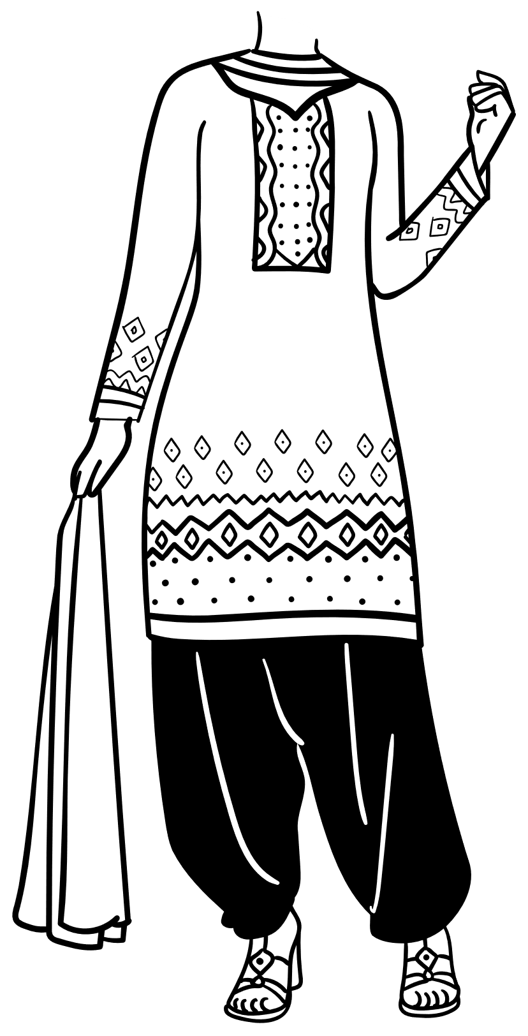
INTRODUCTION
This website is used to connect user to the local tailor who go to their homes for user convenient.
Here simple explanation :-
Imagine , A house having a marriage function and they need a tailor for stitching the material but they didn’t have time to go to the tailor . So, in this case they will visit this website and book an appointment with them.
The local tailor nearby them or whoever the tailor they want will go to their house and pick up the material and take the measurements of them stich it and deliver it.
Tailor first will receive the request of the appointment if the tailor is free or will be able to handle the customer more than 4-5 so Tailor will accept it otherwise denied it the appointment or booking request.
04

Slide 4

PLANNING
Input Goals :- STICH IT (title)
OBJECTIVE :- To give tailor service to the user at their doorsteps.
Category :- A Dynamic Website
Existing Model :- No this type of website doesn’t exists.
Solution :- We designing this website to help the user as well as local tailor which are not recognized by the user . This website will help to those tailor where customer doesn’t visit. In this user will also get benefit because tailor will visit to their house and also provide home delivery.
03

Slide 5

ANALYSIS
Architecture :- 3-tier architecture
Technology :- Java , HTML , CSS
Model :- Model View Controller [MVC]
Hardware requirements :- Intel core i3 10th gen processor , 6GB RAAM , SSD or higher
Software Requirements(While Development) :- JDK, JRE, MySQL ,SQLyog, Apache Tomcat Server/Glassfish Server, NetBeans/Eclipse IDE..
05

Slide 6



REQUIREMENT GATHERING
ADMIN
login, change password, create tailor account, delete tailor account, view complain, delete feedback, view feedback ,update complain status , delete complain, view user accounts, view tailor accounts, view request, view response, logout
TAILOR
USER
signup, login, change password, delete account, view complain, view feedback, send response, view appoinment request, logout
Sinup, login, give feedback, give complain, view feedback, view tailor, send appointment request, view response, logout
05

Slide 7


Database Table
Tailor Table
tailorId – String
tailorPassword - String
address - String
city - String
contact – long
gender - String
mailId - String
Admin table
Request table
requestId -String
fullName – String
contact – long
request - String
adminId - String
adminPassword -String
User Table
Complain Table
complainId -String
fullName - String
status - String
contact - long
mailId – String
complain - String
Response table
userId -String
userPassword –String
contact – long
address - String
city - String
mailId - String
responseId -String
fullName – String
contact - long
response - String
feedback table
fullName -String
feedback - String
06

Slide 8
Designing
03

Slide 9



Admin
STICH IT
Login Id
Password
Log in
07

Slide 10





Stich It
Search
Home
About Us
Book Appointment
Log Out
STICH
IT
Tailor Service at your doorstep
PICK . STICH . DELIVERY
Contact Us
06

Slide 11

Stich It
Search
Home
About Us
Book Appointment
Log In
STICH
IT
Tailor Service at your doorstep
PICK . STICH . DELIVERY
Contact Us
06

Slide 12


User/Tailor login Portal
Log in
Username or Email address
Password
Log in
07

Slide 13

User Sign Up Portal
First Name
Last Name
Mobile NO.
Email
Password
Address
Sign Up
07

Slide 14

Tailor Sign Up Portal
Upload
First Name
Last Name
Mobile NO.
Email
Password
Address
Gender
Create Account
07

Slide 15

Stich It
Search
Home
About Us
Book Appointment
Log Out
Your profile
Book appointment
Contact us
Feedback
Complain
Track status
Log Out
STICH
IT
Tailor Service at your doorstep
PICK . STICH . DELIVERY
Contact Us
06

Slide 16
Stich It
Search
Home
About Us
Book Appointment
Log Out
Your profile
Book appointment
Contact us
Feedback
Complain
Track status
Log Out
STICH
IT
Tailor Service at your doorstep
PICK . STICH . DELIVERY
Contact Us
06

Slide 17
Upload
Full Name
Mobile NO.
Email
Address
Gender
Mobile no.
Password
New Password
Confirm Password
Forget Password?
OTP
Resend OTP in : 00:20
Update Profile
07

Slide 18
Stich It
Search
Home
About Us
Book Appointment
Log Out
Your profile
Book appointment
Contact us
Feedback
Complain
Track status
Log Out
STICH
IT
Tailor Service at your doorstep
PICK . STICH . DELIVERY
Contact Us
06

Slide 19
THANK YOU!
10

